Slide 1
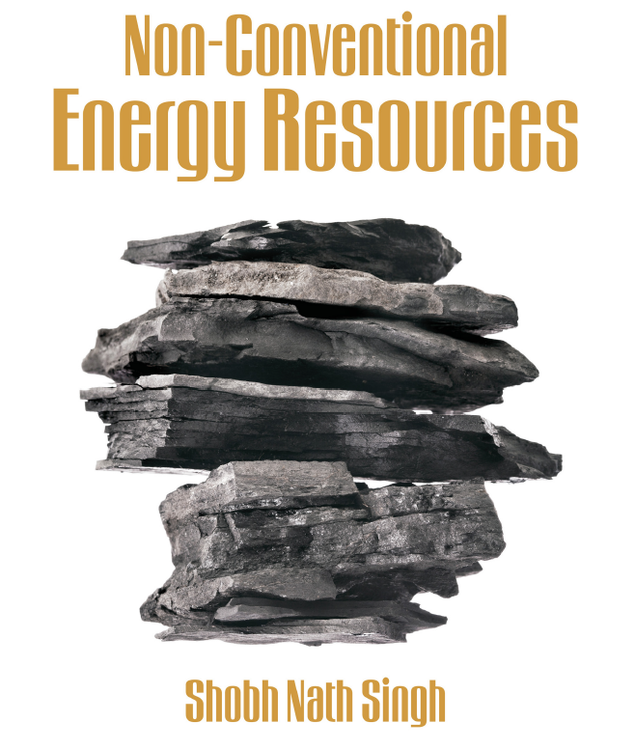

Slide 2
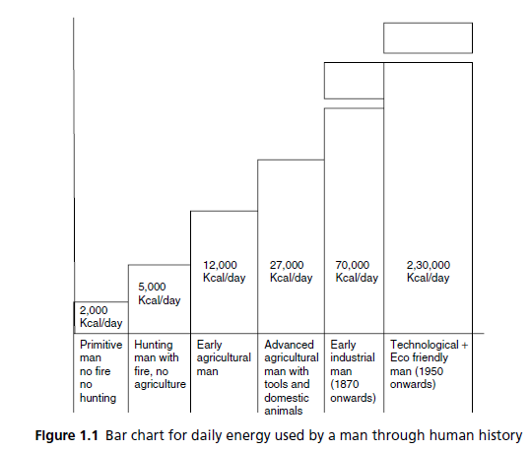
HISTORY OF HUMAN CIVILIZATION

Slide 3
Energy Crises

Slide 4
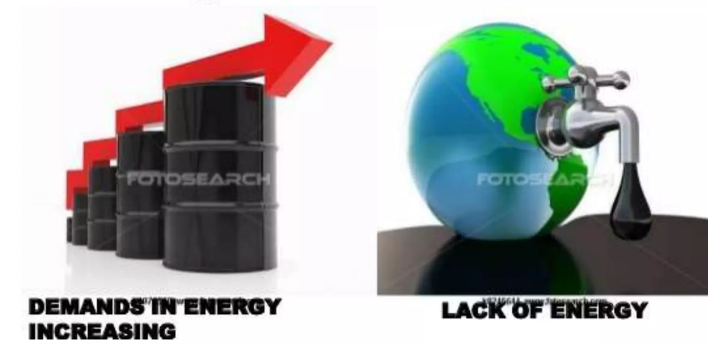
Definition:
The supply of energy is far less than its demands can affect the whole mankind to run towards the development or daily purposes that crises is called Energy Crises.

Slide 5
Causes of Energy Scarcity
Increasing Population
Increasing Energy Usage or Consumption
Uneven Distribution of Energy Resources
Lacks of Technical Knowhow
Oil shortage
Coal shortage
Power shortage
Natural disasters
Attack by Terrorists

Slide 6
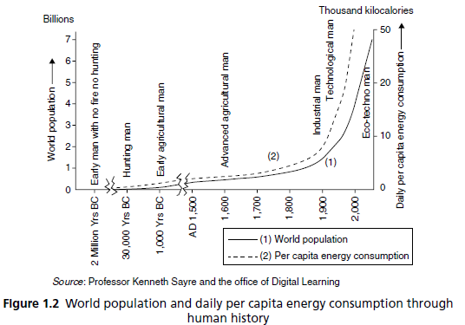
Increasing Population

Slide 7
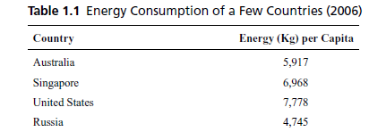
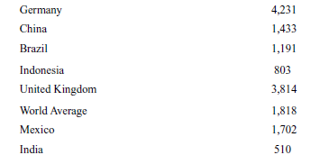
Increasing Energy Usage or Consumption

Slide 8
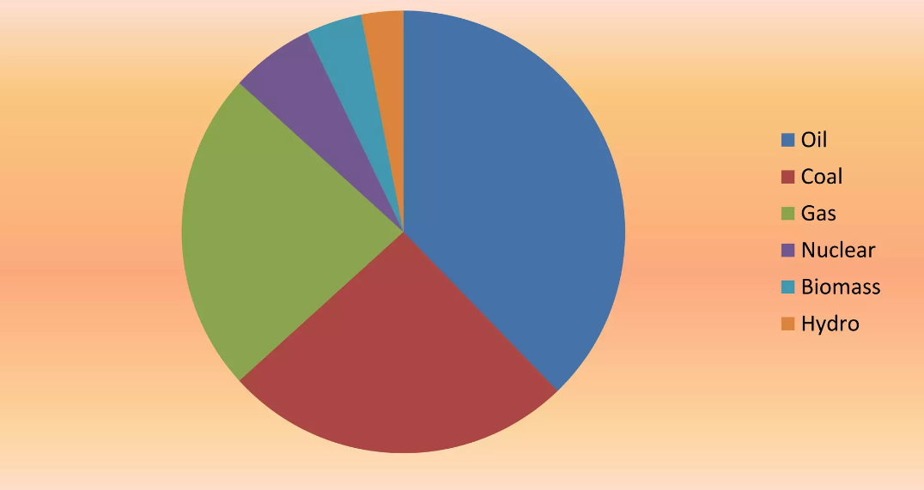
Present usage of different types of energy

